Slide 1

Roman architecture & Engineering (A&E), 753 BC to 476 AD Joseph T Wunderlich PhD BS Architectural Engineering, U Texas (Austin) 1984 Urban Design, UCSD 1986-87 Full-time A&E in PA, TX, and CA in 1980’s; part time to present Hi-tech in 90’s to present (M.Eng, PhD, IBM Research, Purdue Prof, etc.) Six trips to Italy as of 2020, including teaching a PhD course at U Trento

Slide 2
roman A&E spanned 1,229 years (753 BC to 476 AD) Initially a Roman Kingdom, then a ROMAN Republic (with elections, but not a democracy) from 509BC Then the ROMAN Empire, with Emperors, from 27BC unlike the Greeks, Roman expansion spread their power and control to many places throughout Europe, the Middle East, and Africa. The Romans had conquered all of the Greek city-states by 146BC

Slide 3
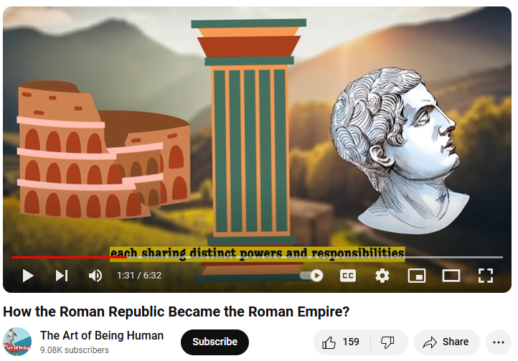
roman A&E spanned 1,229 years (753 BC to 476 AD) Initially a Roman Kngdom, then a ROMAN Republic (with elections, but not a democracy) from 509BC Then the ROMAN Empire, with Emperors, from 27BC
VIDEO

Slide 4
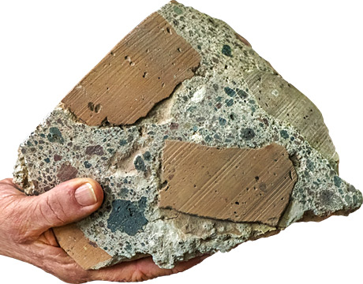
SOURCE: https://www.asme.org/engineering-topics/articles/technology-and-society/ancient-roman-concrete-stands-test-time
Roman CONCRETE
Roman concrete mixed lime, VOLCANIC ASH, and VOLCANIC ROCK (the aggregate) to build structures lasting over 2000 YEARS:
Large buildings
Bridges and Roads
Sewers and Aqueducts
Piers and breakwaters
Along coastline to protect busy shipping harbors
Modern-day concrete, even when reinforced with rebar, might only last 100 YEARS in a marine environment
STOP here and learn more about concrete in Wunderlich lecture on “Concrete” in Materials & Methods course:
PPTX-audio PDF CLOUDw/transcript MP4 YouTube

Slide 5
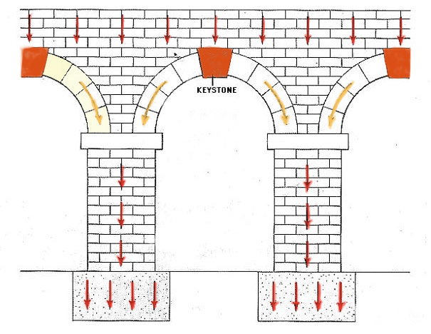
SOURCE: http://aventalearning.com/content168staging/2008Latin1A/unit3/section5f.html
>2500 years ago
Roman ARCH
Distribution of Forces shown by arrows in the figure

Slide 6
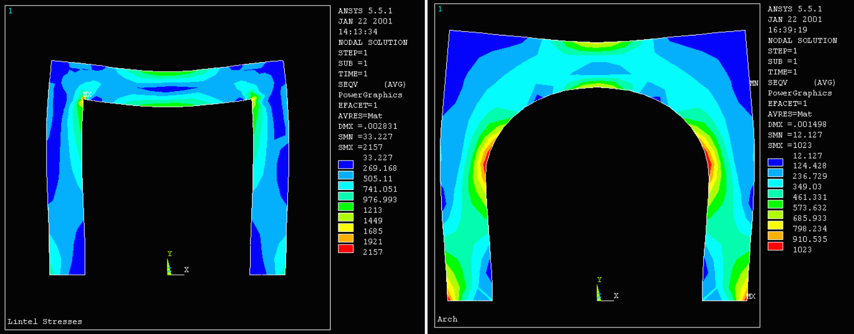
SOURCE: http://infohost.nmt.edu/~es421/ansys/archfull.htm
>2500 years ago
Roman ARCH
Figure 1 shows internal stress in a post-and-beam lintel while Fig. 2 shows stresses in an arch
Legend on lower right shows maximum stresses in arch are half those in lintel..
Red areas delineate highest relative stresses, blue show lowest.

Slide 7
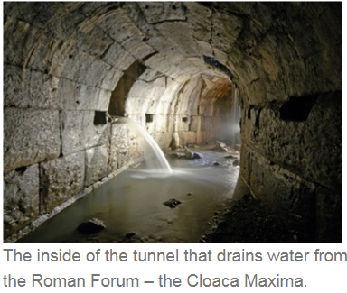
>2500 years ago
~600BC Roman SEWERS (still function today)
Source https://quatr.us/romans/roman-sewage-ancient-roman-toilets-poop-pipes.htm

Slide 8
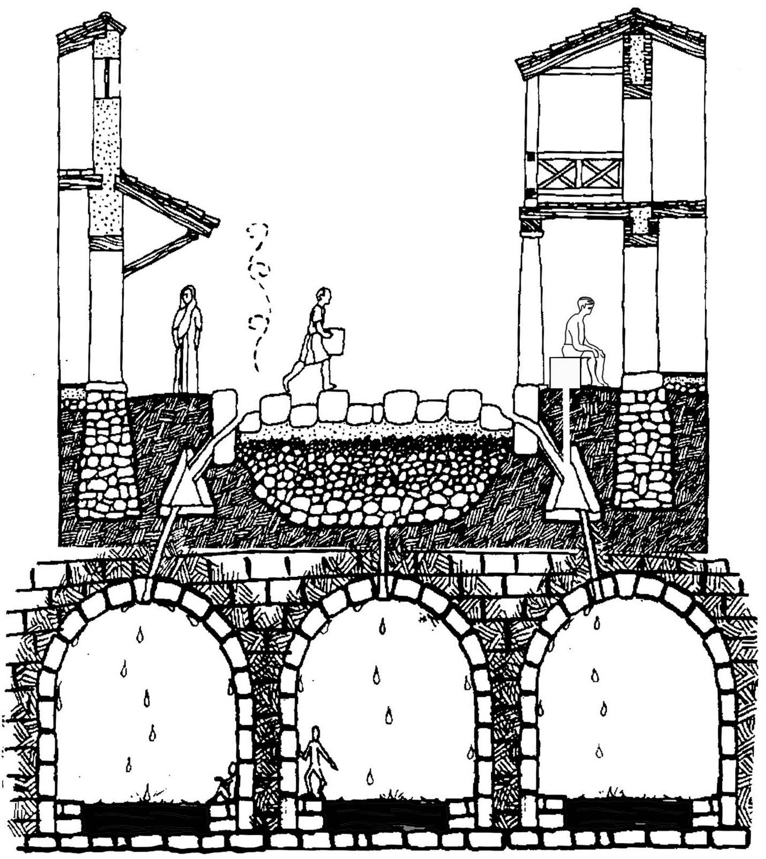
>2500 years ago
Roman SEWERS (SEWAGE and STORMWATER RUNOFF combined)
Source https://www.pinterest.com/pin/472666923385677089/

Slide 9
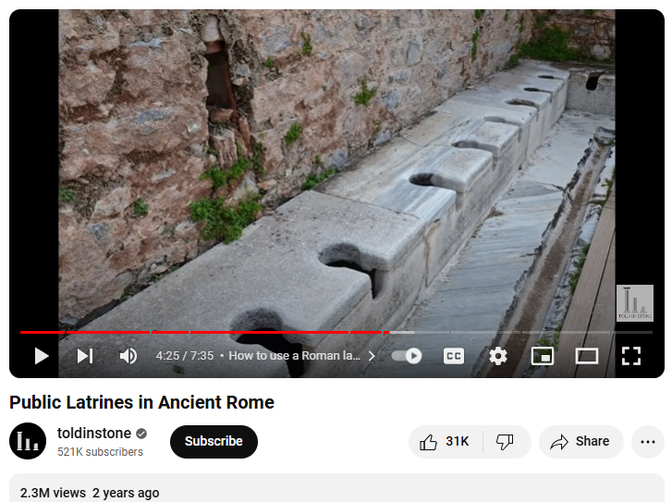
>2500 years ago
Roman SEWERS (SEWAGE and STORMWATER RUNOFF combined)
Watch VIDEO … only 4:22 to 7:05

Slide 10
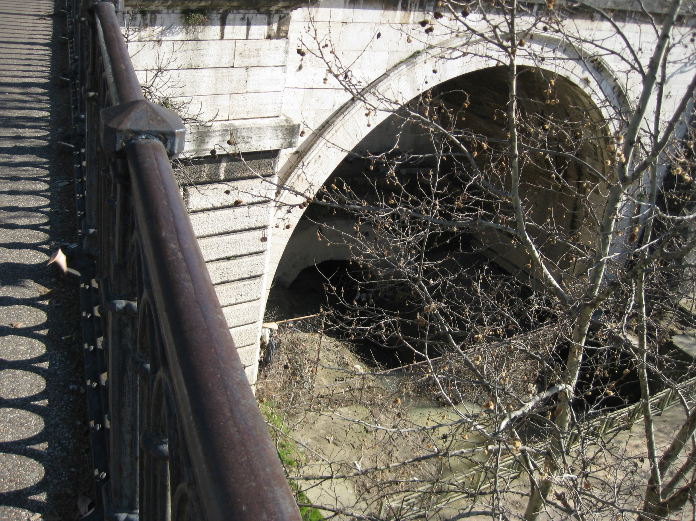
>2500 years ago, and still working !
Roman SEWERS
Photo by J Wunderlich in Rome in 2011 of working sewer from Roman times (but just for STORMWATER RUNOFF now – dumping into river)

Slide 11
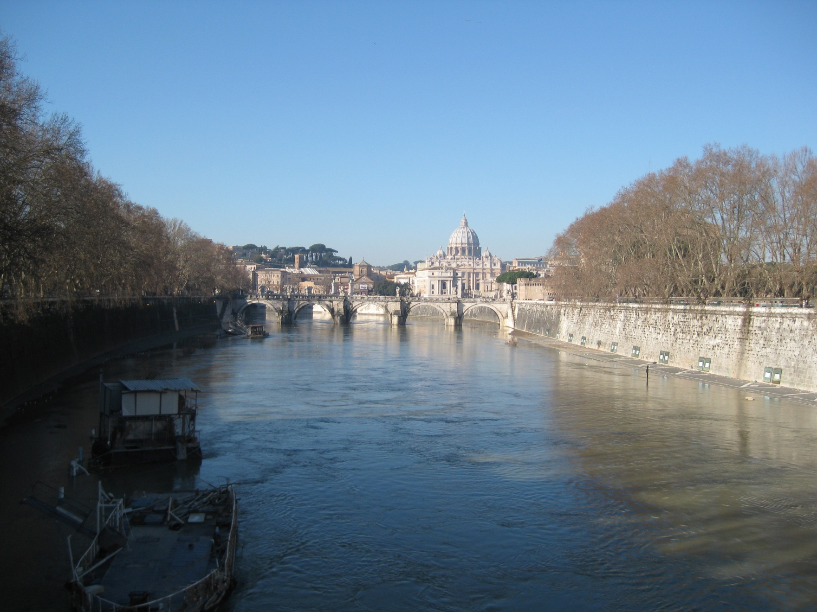
>2500 years ago
Roman SEWERS
In Roman times, raw sewage was also dumped into the Tiber River
(Photo by J Wunderlich in Rome, 2011)

Slide 12
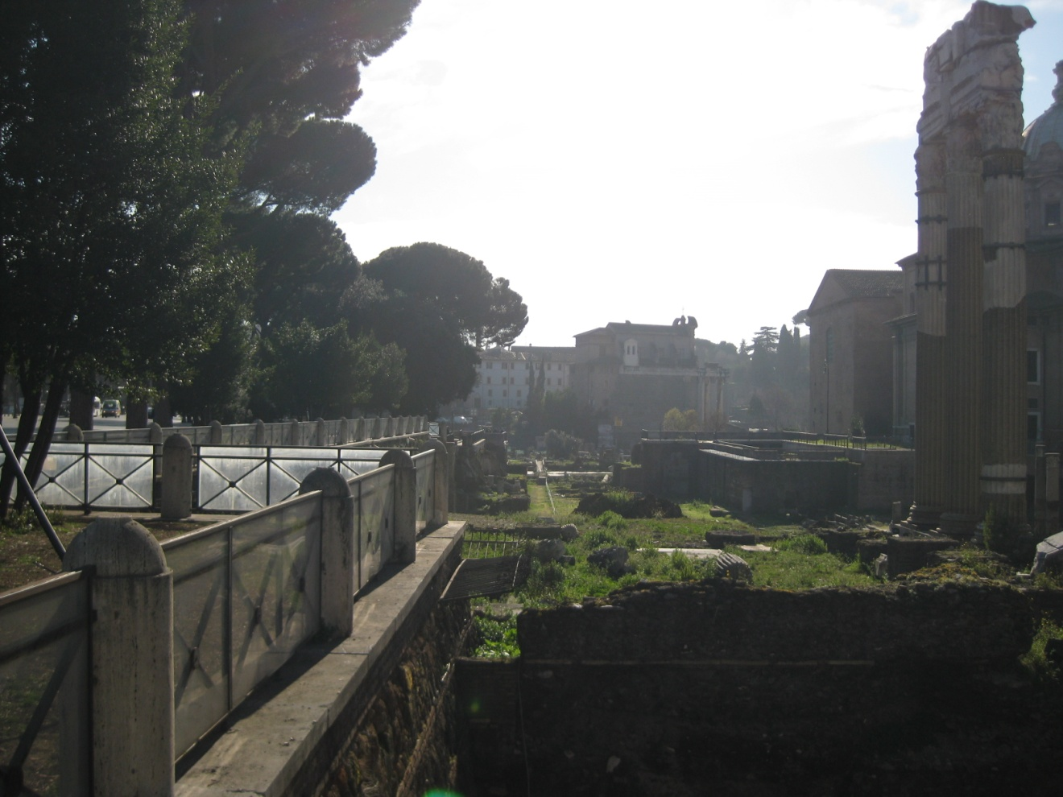
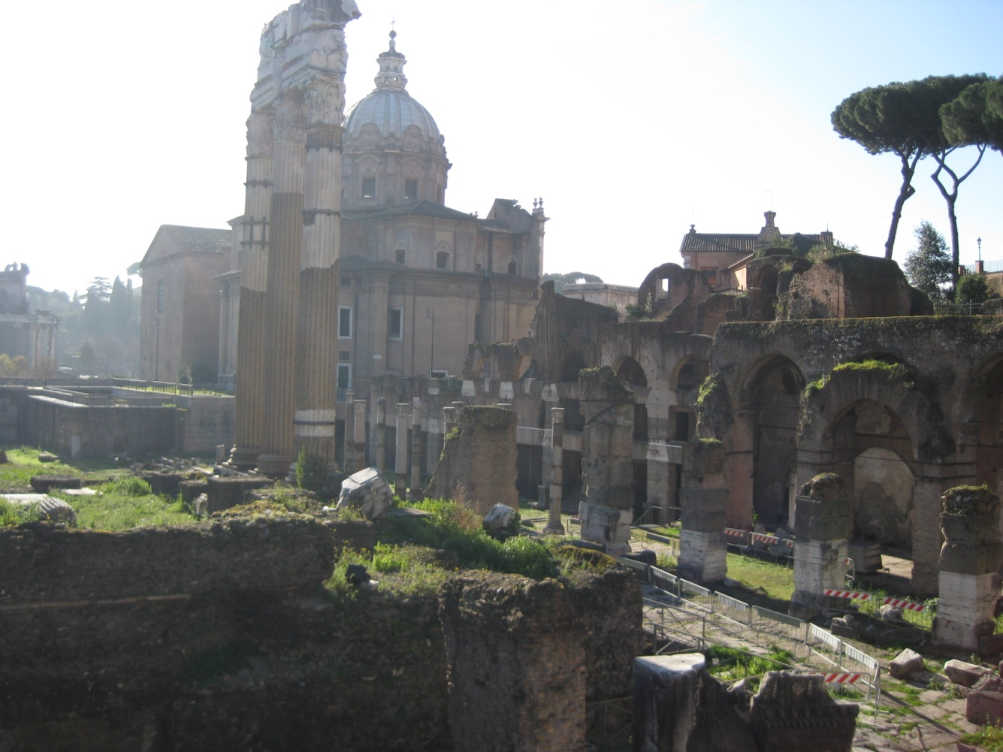
>2500 years ago
Roman SEWERS (“Cloaca Maxima”)
Allowed draining swamp that became the “FORUM”,
Consolidating the tribes on the surrounding hills into a unified culture
Photos by J Wunderlich in 2011

Slide 13
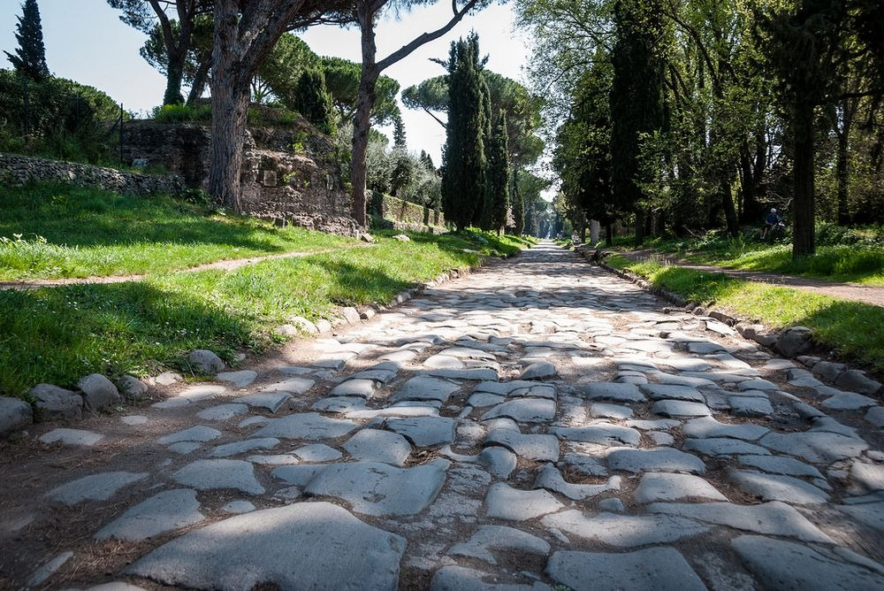
Romans built over 53,000 miles of ROADS SOURCE: https://www.amusingplanet.com/2017/09/appian-way-first-roman-road.html
2300 years ago
Apian Way, 312 BC

Slide 14
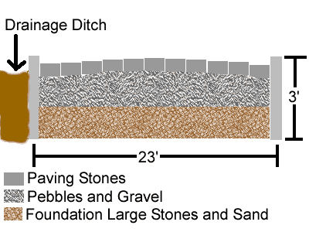
The ROADS were first surveyed to keep them straight, and then built by hand. Roads were sloped from the center so rainwater would drain off into ditches SOURCE: http://historylink101.com/2/Rome/roman-roads.htm ROAD Type #1

Slide 15
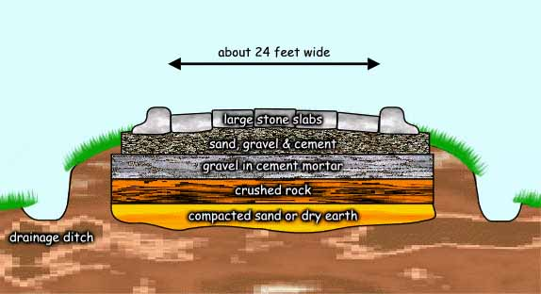
SOURCE: http://www.crystalinks.com/romeroads.html ROAD Type #2
2300 years ago

Slide 16
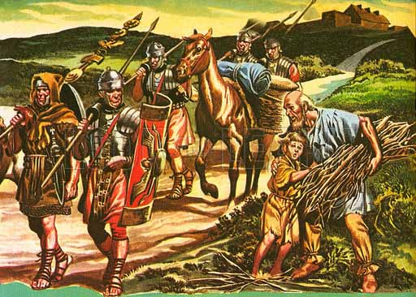
A unit of Roman officers called chief builders (“architecti”) were in charge; Educated in Geometry, they had a staff of land surveyors ("agrimensores") and levelers (“libratores"). Construction workers taken from the ranks carried weapons, rations, and utensils; And possibly a saw, hatchet, sickle, pick, or spade for road construction work. SOURCE: http://www.crystalinks.com/romeroads.html
Romans built over 53,000 miles of ROADS
2300 years ago

Slide 17
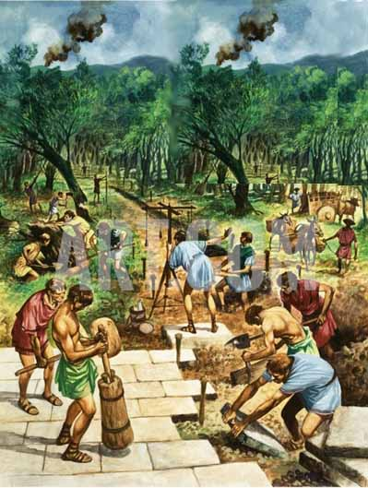
Slaves, prisoners of war, and convicted criminals performed the quarrying and transporting of stone. SOURCE: http://www.crystalinks.com/romeroads.html
Romans built over 53,000 miles of ROADS
2300 years ago

Slide 18
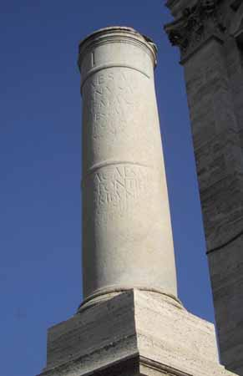
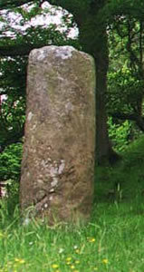
Stone mile markers placed along roads SOURCE: http://historylink101.com/2/Rome/roman-roads.htm
Romans built over 53,000 miles of ROADS
2300 years ago

Slide 19
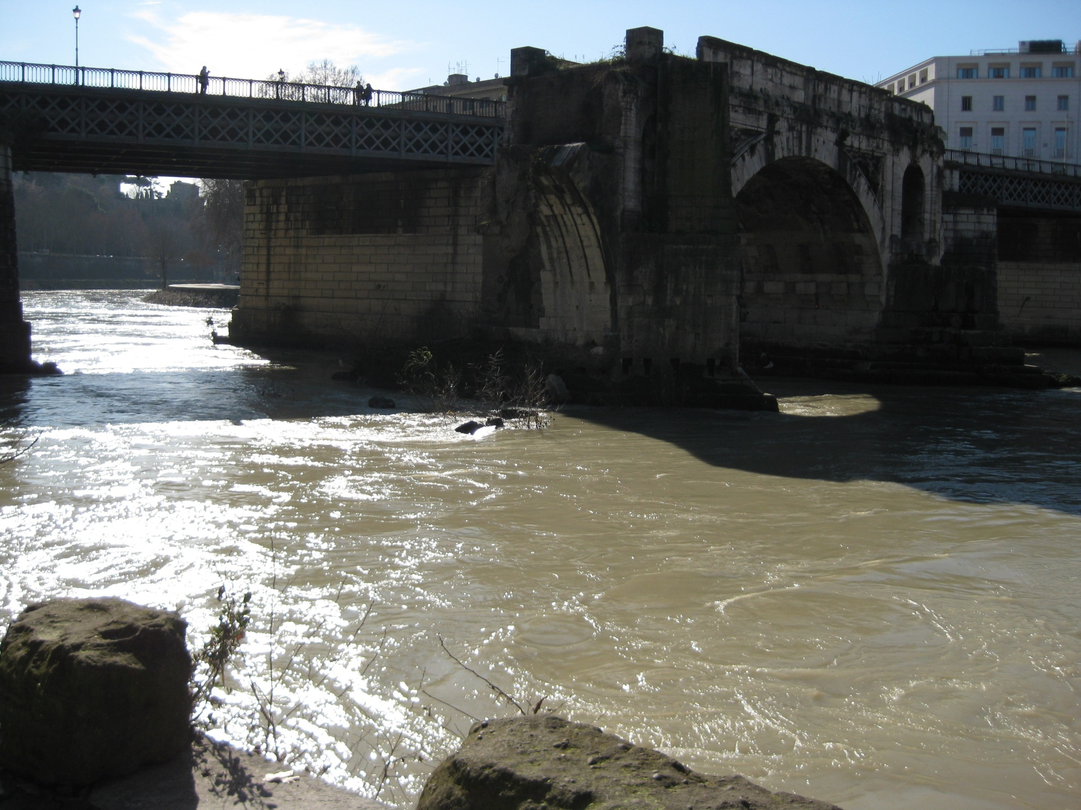
Roman BRIDGES
2200 years ago
“Ponte Rotto“ (Broken Bridge) in Rome. Built in 141 BC. Photo by J Wunderlich 2011
https://www.througheternity.com/en/blog/hidden-sights/ponte-rotto-romes-broken-bridge.html

Slide 20
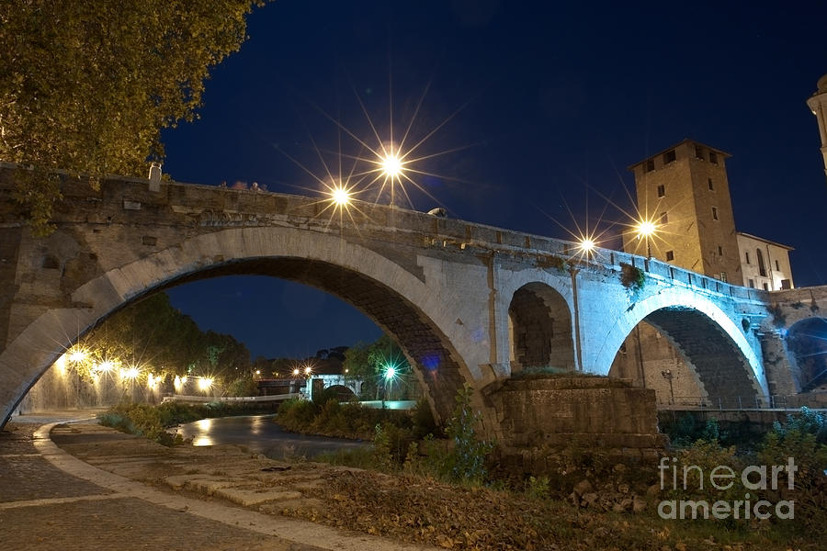
Roman BRIDGES
2100 years ago
Pons Fabricius is oldest Roman bridge in Rome in its original state.
Built in 62 BC https://en.wikipedia.org/wiki/Pons_Fabricius https://fineartamerica.com/featured/pons-fabricius-fabrizio-ruggeri.html

Slide 21
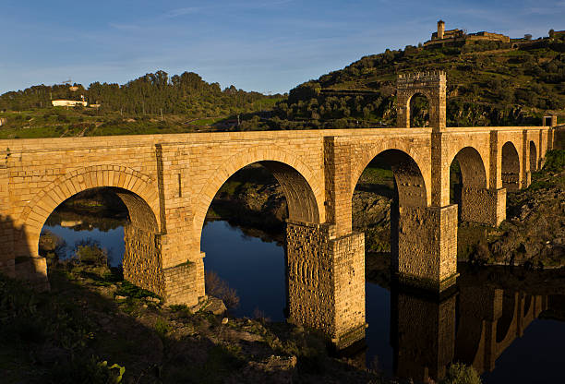
Roman BRIDGES
1900 years ago
“Alcantara “ Roman Bridge in Spain. Built in 106 AD
https://www.istockphoto.com/photos/alcantara-bridge?page=2&sort=mostpopular&mediatype=photography&phrase=alcantara%20bridge

Slide 22
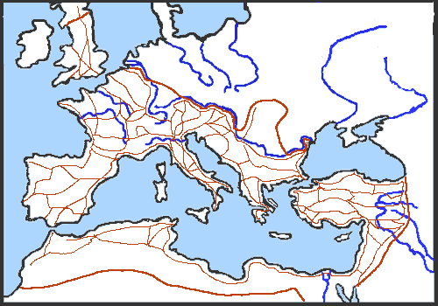
Romans built over 53,000 miles of roads to connect every part of their empire. They had a saying "All roads lead to Rome.“ SOURCE: http://historylink101.com/2/Rome/roman-roads.htm
~2000 years ago

Slide 23
Roman Legions of soldier/builders didn't need WAY-STATION’s since they had a baggage train, and they constructed their own camp every evening Others did, and PASSPORTS were required Carts could travel 8 miles per day, pedestrians a little more Way-stations were 15 to 18 miles apart Often a permanent military camp or town grew there Private systems of refreshments also grew there SOURCE: http://historylink101.com/2/Rome/roman-roads.htm
~2000 years ago
Romans built over 53,000 miles of ROADS

Slide 24
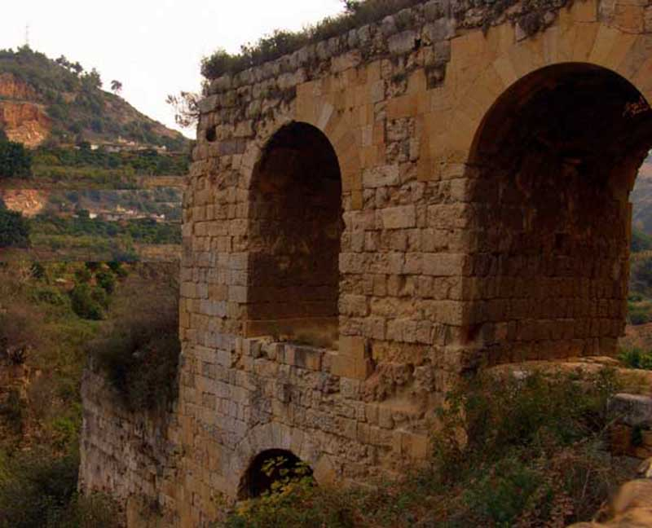
Government maintained way station (“mansiones”) SOURCE: http://historylink101.com/2/Rome/roman-roads.htm
Romans built over 53,000 miles of ROADS
~2000 years ago

Slide 25
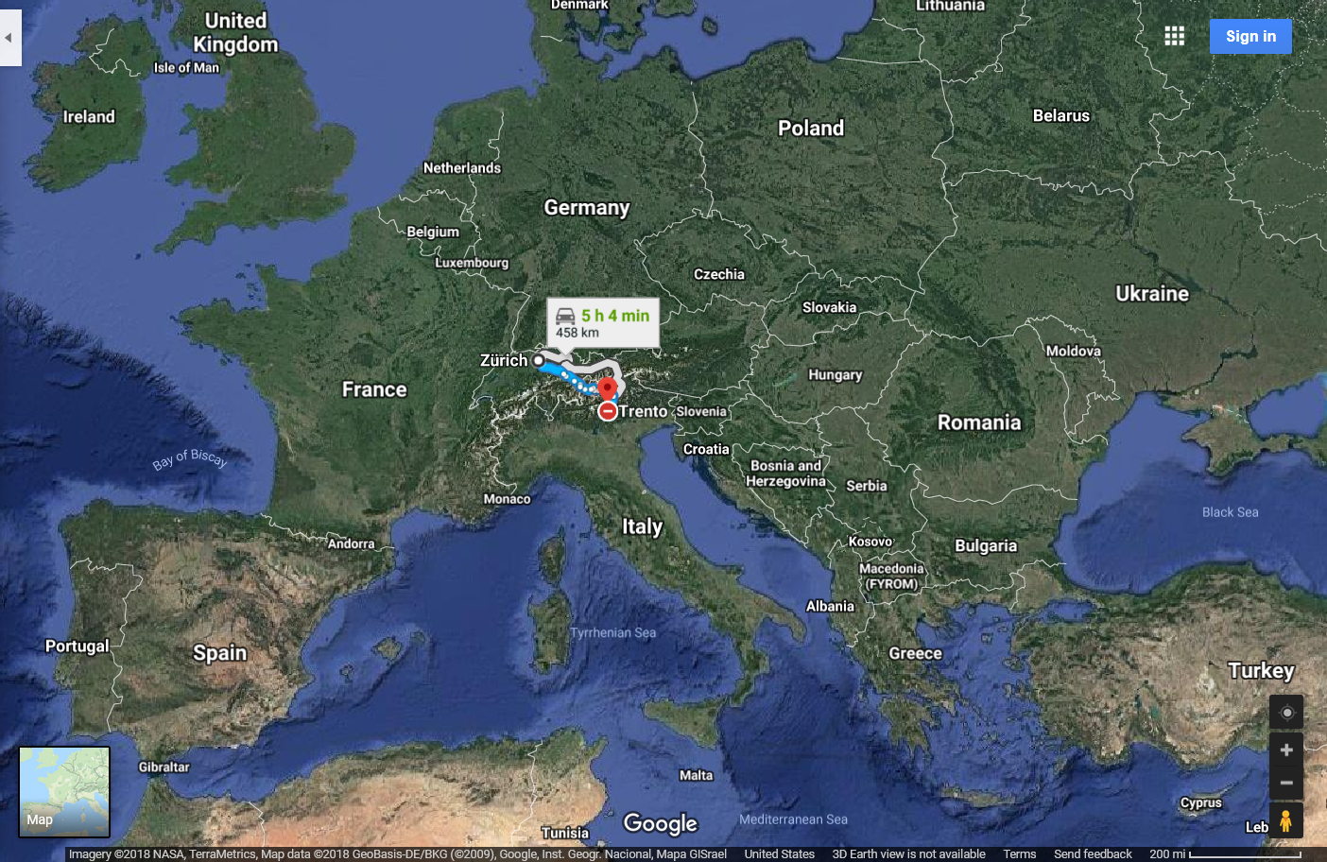
J Wunderlich story (listen to audio)

Slide 26
J Wunderlich story (listen to audio)

Slide 27
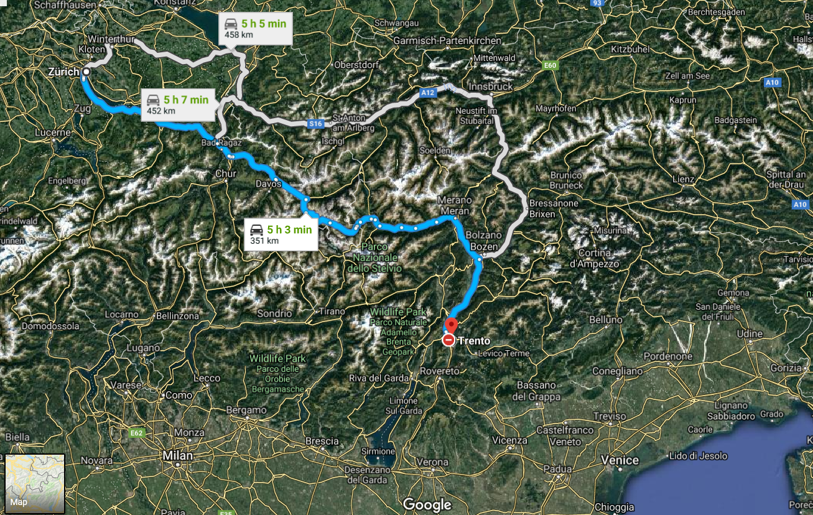
J Wunderlich story (listen to audio)

Slide 28
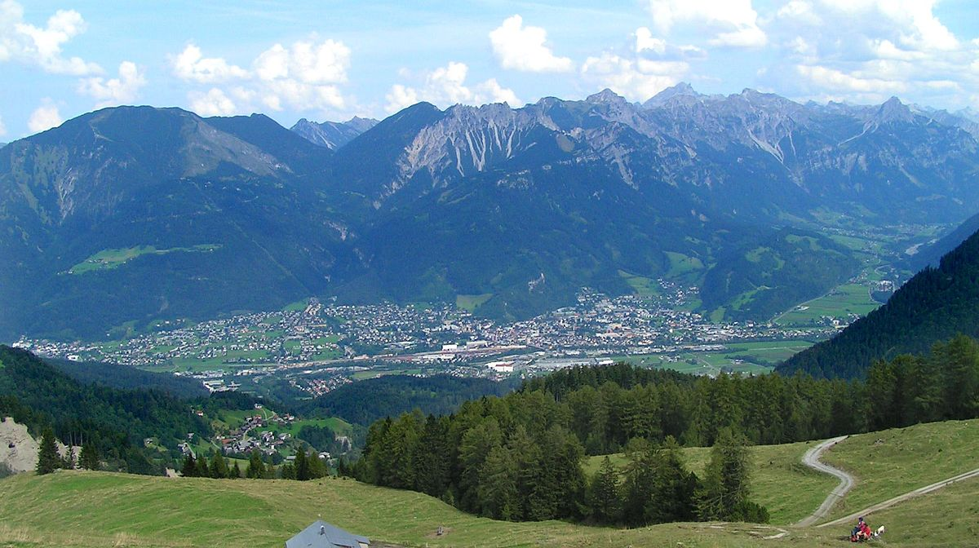
J Wunderlich story (listen to audio)

Slide 29
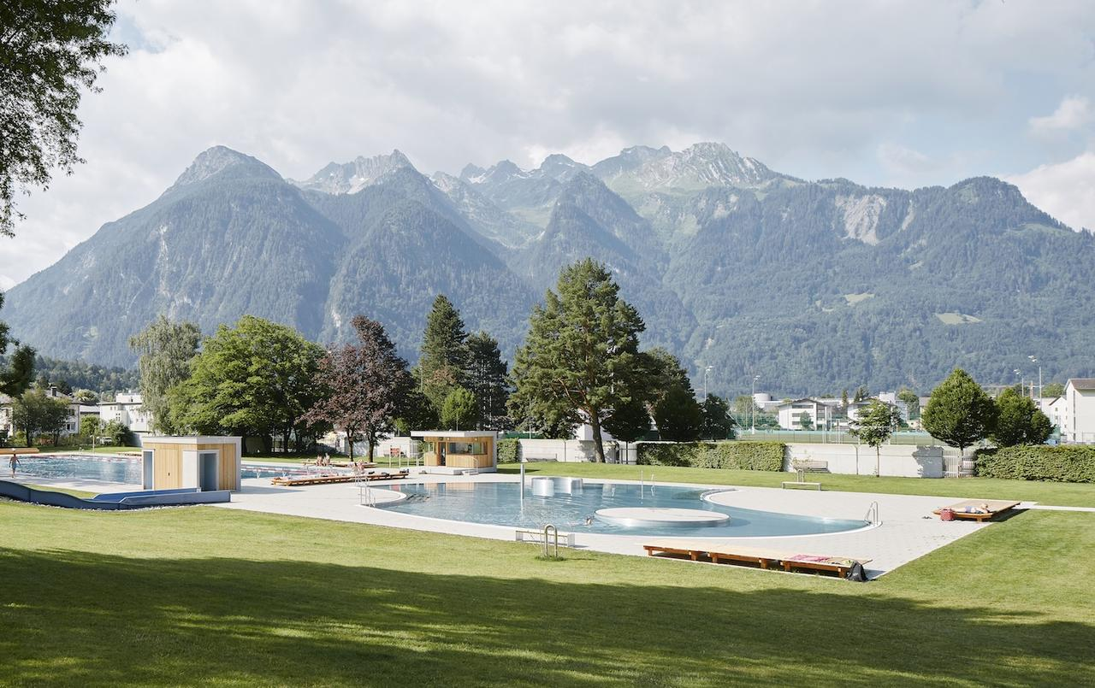
J Wunderlich story (listen to audio)
Val Blu Sporthotel & Spa
Photo from http://www.valblu.at/de/hotel-wellness-vorarlberg-bludenz-valblu.html
/

Slide 30
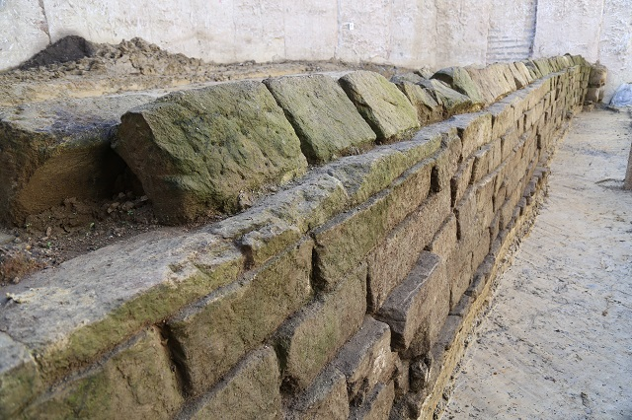
WATER SUPPLY for cities by Roman AQUEDUCTS
2300 years ago
Aqua Appia, Rome 312 AD
https://www.archaeology.org/news/5434-170406-rome-oldest-aqueduct

Slide 31
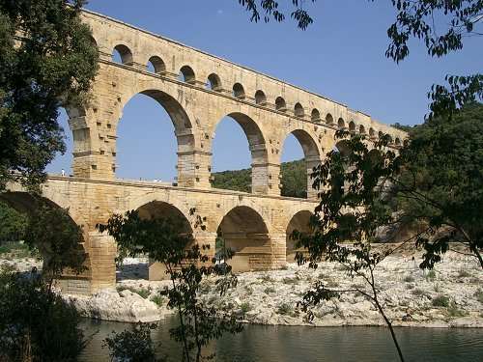
2000 years ago
“Pont du Gard”
Aqueduct
bridge
in
southern France
40-60 AD

Slide 32
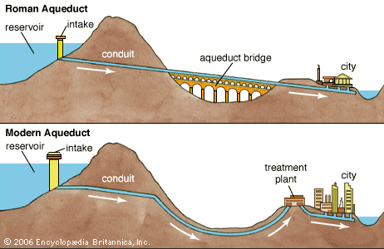
SOURCE: https://www.britannica.com/technology/aqueduct-engineering http://www.crystalinks.com/romeroads.html
>2000 years ago
Roman AQUEDUCTS
Often using only gravity to lead water along a continuous sloping gradient from up to 57 miles away. Rome had eleven aqueducts during time of the Roman Empire.
Using enclosed pipes that can be pressurized, and pumps if needed, to get water to destination

Slide 33
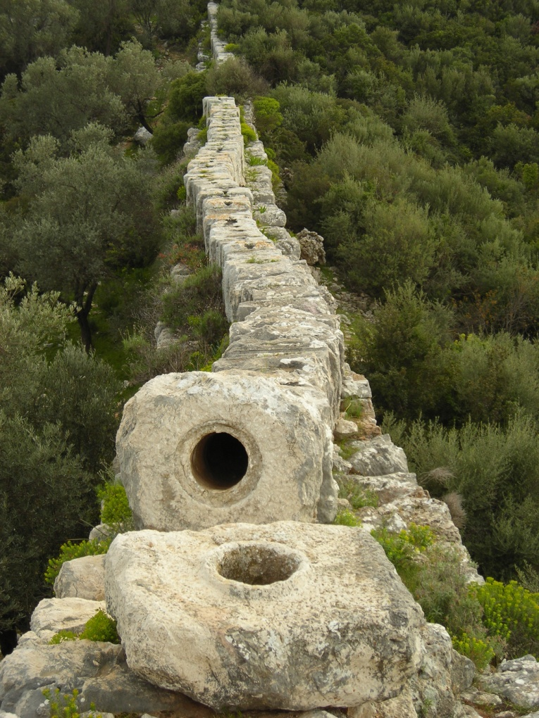
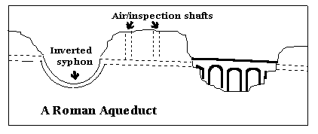
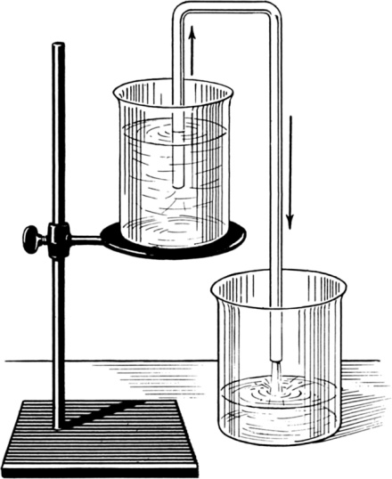
https://sites.google.com/site/theromanaqueducts/design
>2000 years ago
WATER SUPPLY for cities by AQUEDUCTS
Parts of some Roman Aqueducts could however span large valleys by using
“Inverted Siphons”
“Patera” Siphon Aquaduct in Turkey http://www.romanaqueducts.info/aquasite/index.html
A Siphon
https://www.britannica.com/technology/siphon-instrument/media/546445/129487

Slide 34
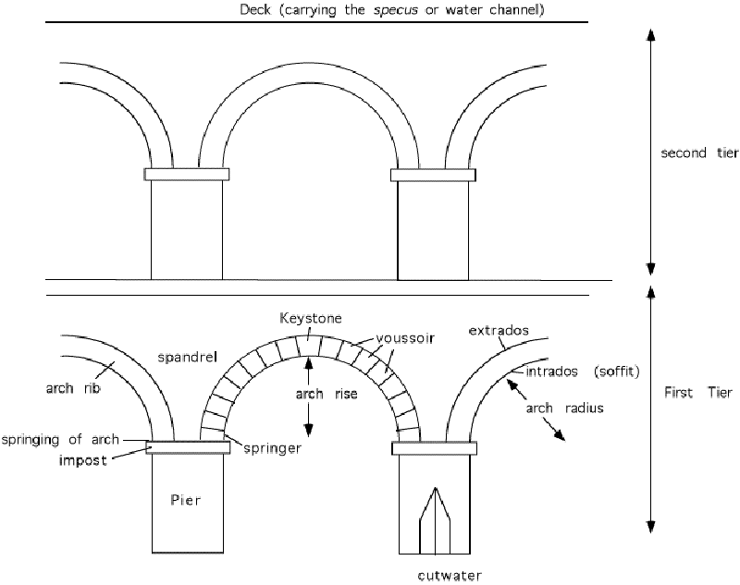
SOURCE: http://www.romanaqueducts.info/introduction/
>2000 years ago
AQUEDUCT BRIDGES

Slide 35
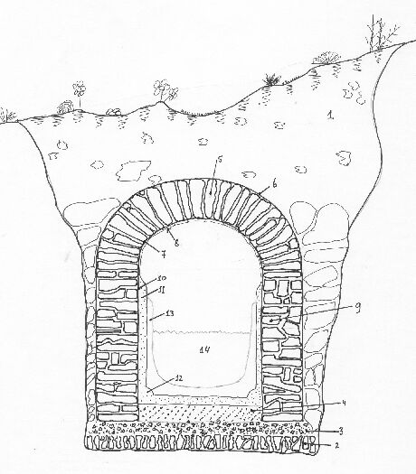
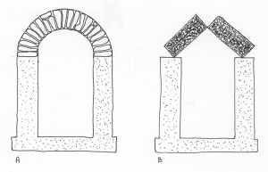
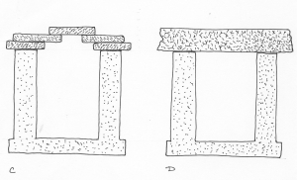
SOURCE: http://www.romanaqueducts.info/introduction/
>2000 years ago
AQUEDUCT CHANNELS (underground conduits)

Slide 36
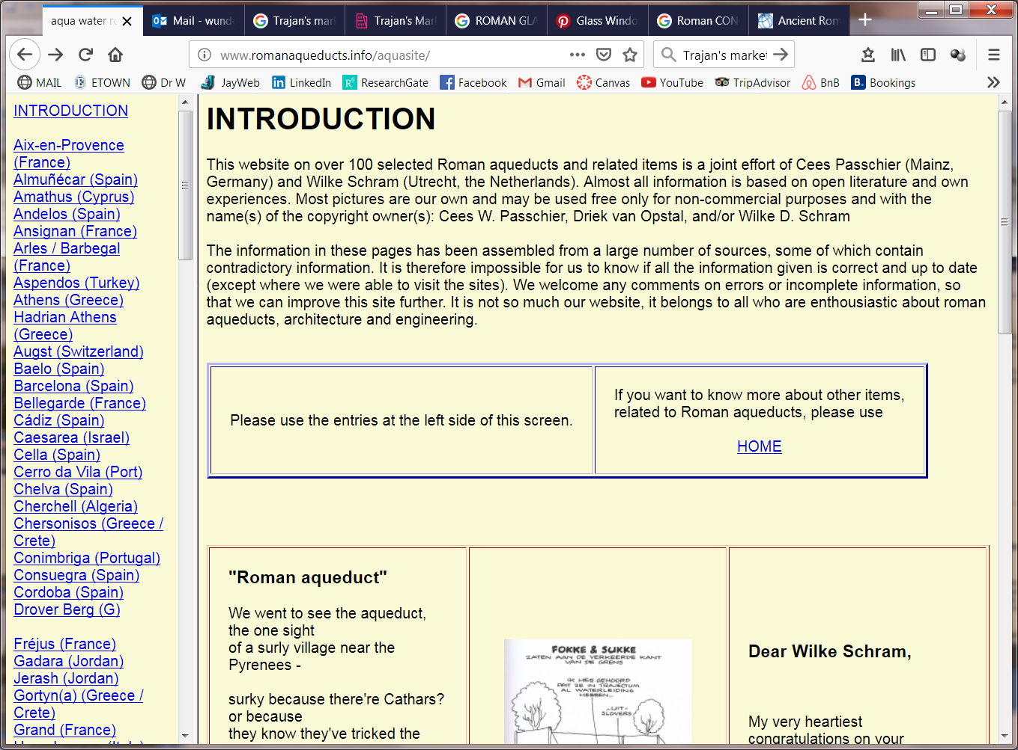
SOURCE http://www.romanaqueducts.info/aquasite/
>2000 years ago
AQUEDUCTS

Slide 37
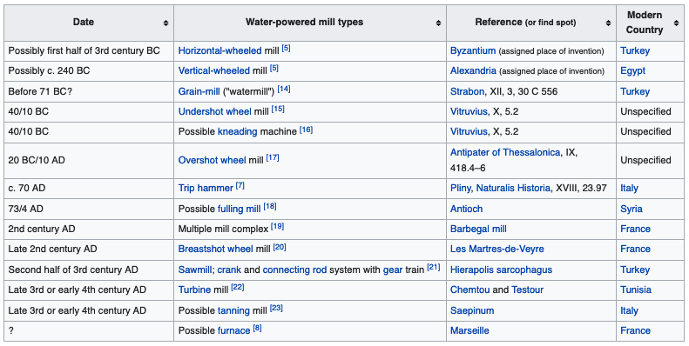
WATER MILLS
The earliest instance of a machine harnessing natural forces to replace human muscular labor (apart from the sail). [source]

Slide 38
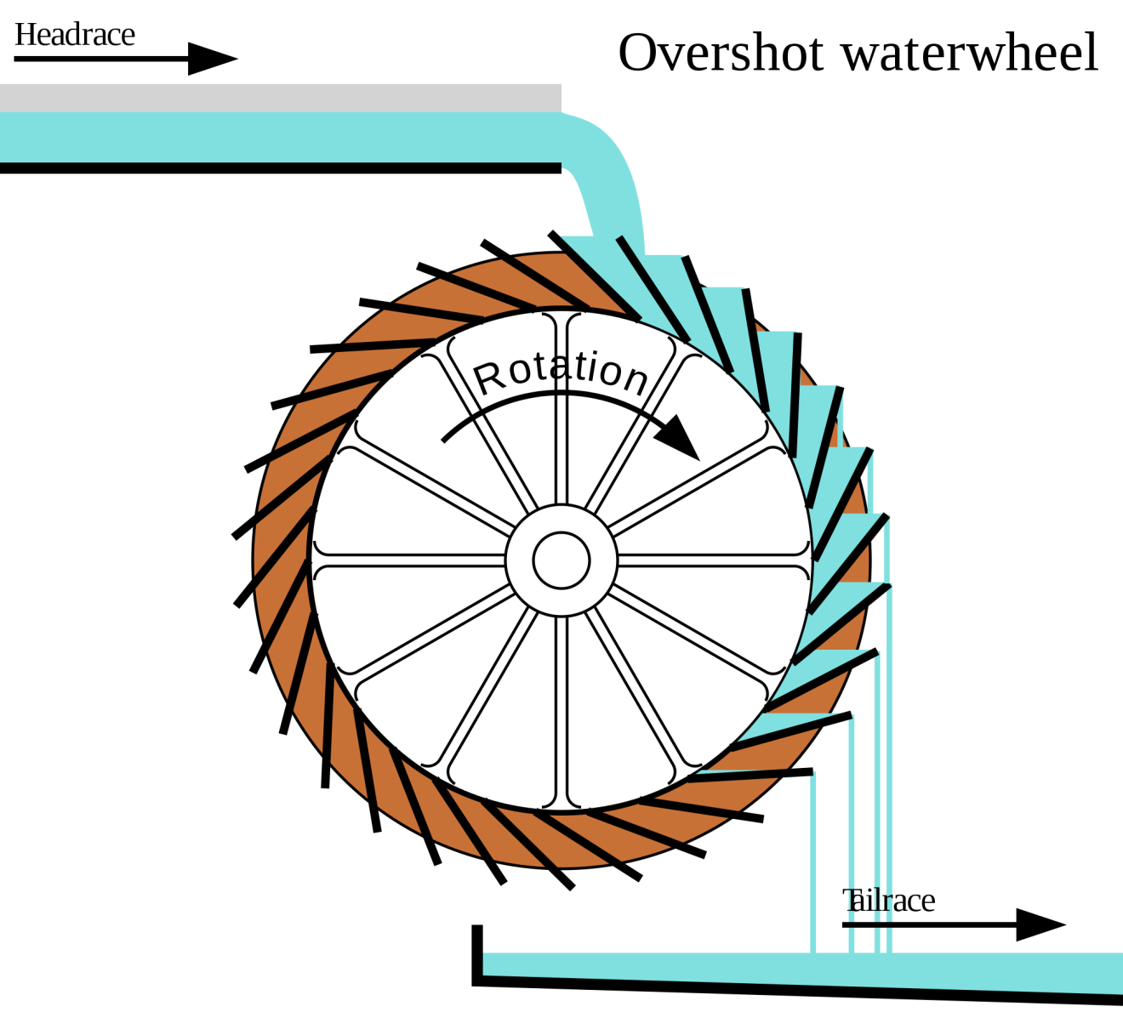
WATER MILLS
The Roman OVERSHOT WHEEL was more powerful than previous waterwheels
l https://www.dailymail.co.uk/sciencetech/article-6138001/Enormous-Roman-biscuit-factory-powered-16-water-wheels-used-make-food-sailors.html

Slide 39
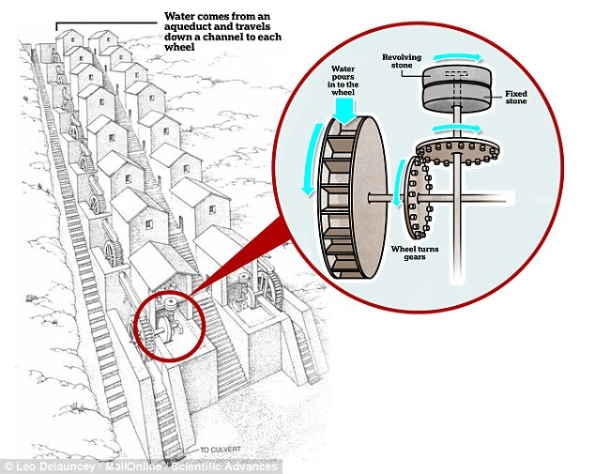
Roman WATER MILLS

Slide 40
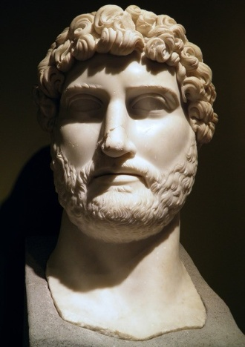
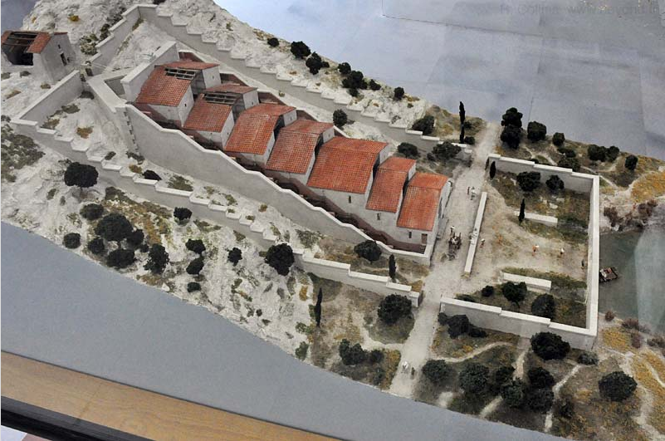
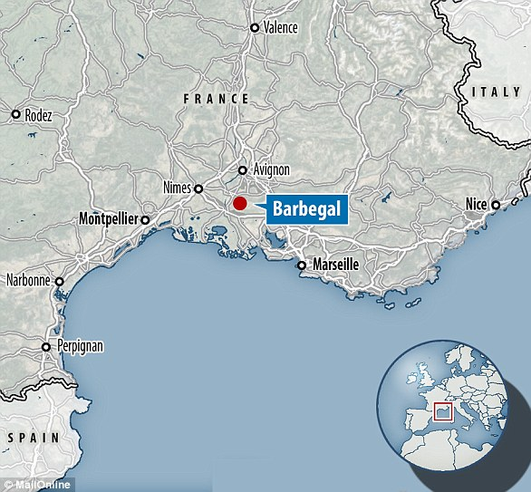
~2000 years ago
Roman WATER MILLS
Emperor Hadrian
117 to 138 AD
https://www.ancient.eu/hadrian/
The Roman Barbegal Mill /Aqueduct (100-200 AD)
FLOUR FACTORY could feed 12,000 people per day
https://advances.sciencemag.org/content/4/9/eaar3620

Slide 41
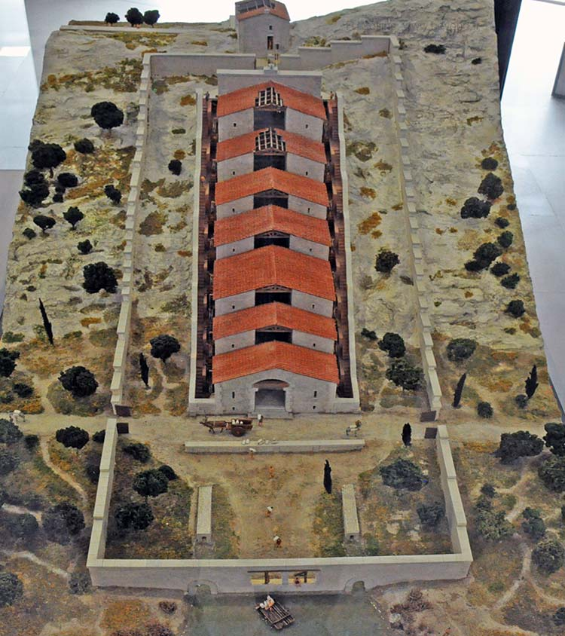
~2000 years ago
Roman WATER MILLS
Emperor Hadrian
117 to 138 AD
https://www.ancient.eu/hadrian/
The Roman Barbegal Mill /Aqueduct (100-200 AD)
FLOUR FACTORY could feed 12,000 people per day
https://advances.sciencemag.org/content/4/9/eaar3620

Slide 42
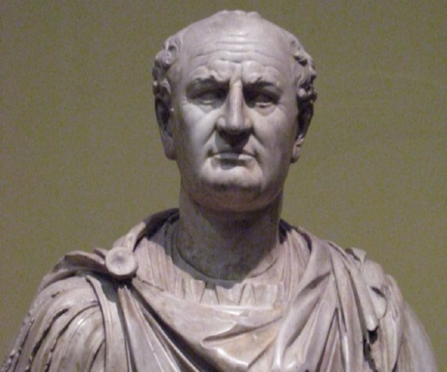
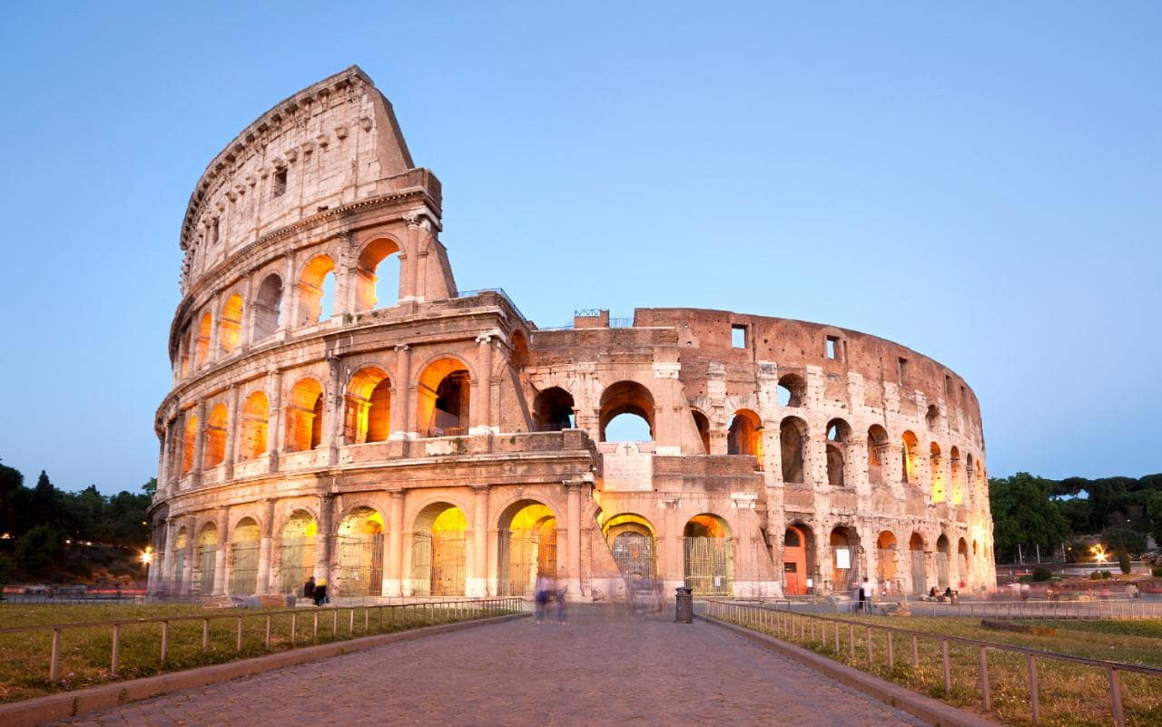
Colosseum in Rome built 70 to 80 AD held ~50,000 people
2000 years ago
Emperor Vespasian
69 to 79 AD
https://www.britannica.com/biography/Vespasian/

Slide 43
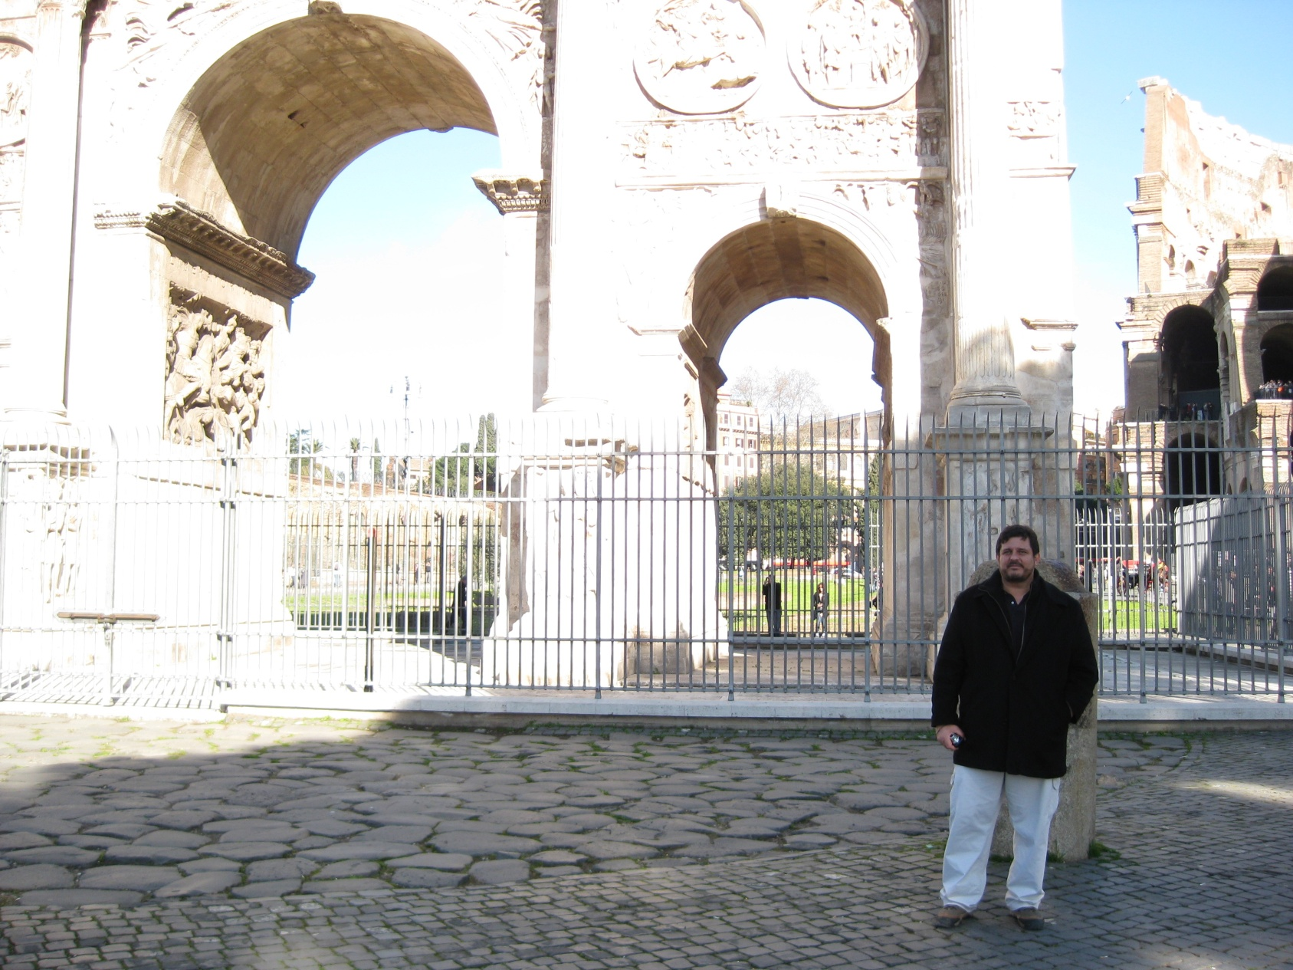
J Wunderlich at the gate to the COLISEUM in Rome in 2011
Roman COLOSSEUM

Slide 44
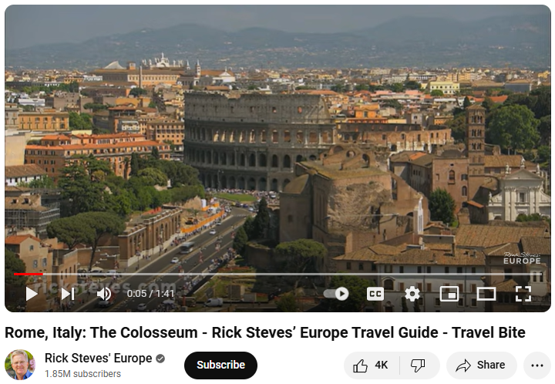
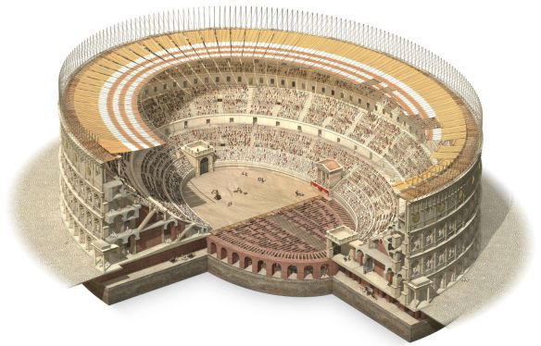
2000 years ago
Roman COLOSSEUM
Emperor Vespasian
69 to 79 AD
https://www.britannica.com/biography/Vespasian/
VIDEO
Source: https://www.dkfindout.com/us/history/ancient-rome/beneath-colosseum/

Slide 45

Initially it could be flooded for sea battles
2000 years ago
Roman COLOSSEUM
Emperor Vespasian
69 to 79 AD
https://www.britannica.com/biography/Vespasian/
Source: https://www.dkfindout.com/us/history/ancient-rome/beneath-colosseum/

Slide 46

ELEVATORS later added to lift animals into battles in the arena
2000 years ago
Roman COLOSSEUM
Emperor Vespasian
69 to 79 AD
https://www.britannica.com/biography/Vespasian/
Source: https://www.dkfindout.com/us/history/ancient-rome/beneath-colosseum/

Slide 47
2000 years ago
Roman PASSIVE SOLAR HEATING
and NATURAL DAYLIGHTING
Used the “GREENHOUSE EFFECT” to admit sunlight into a desired space, and holding
in the heat so it accumulates inside
The earliest known greenhouse in 30 AD for Roman Emperor
Called a specularium, fabricated from small translucent sheets of mica
Built to satisfy the emperor's craving for cucumbers out of season
Large windows of transparent stone like mica, or clear glass
They invented first glass cast windows in 100 AD
Sun-right laws made it a civil offense to block one’s access to the south
Emphasis on proper solar orientation for buildings
Baths faced the afternoon sun in wintertime when they had maximum use
Source http://john-perlin.com/let-it-shine.html

Slide 48


2000 years ago
Roman GREENHOUSE, 37 AD
A residence for Emperor Tiberius on the island of Capri in Italy
Emperor Tiberius
14A to 37 AD
Villa Jovis
Source https://www.capri.com/en/s/villa-jovis-mount-tiberio

Slide 49

2000 years ago
Roman GREENHOUSE, 37 AD
Earliest known greenhouse in 30 AD, for Emperor Tiberius
Built to satisfy his craving for cucumbers out of season
Emperor Tiberius
14A to 37 AD
Villa Jovis
Source http://tanglewoodconservatories.com/blog/alans-book-on-conservatories/

Slide 50

2000 years ago
Roman RAINWATER COLLECTION
The villa set around four huge cisterns with barrel vaults that satisfied water requirements
Sophisticated rainwater collection system.
Emperor Tiberius
14 to 37AD
Villa Jovis
Source https://www.summerinitaly.com/guide/villa-jovis

Slide 51

2000 years ago
First cast
GLASS WINDOWS
Roman GLASS, 100 AD
“Window glass produced based on archeological evidence of ancient Roman glass-making technology”
Source https://www.pinterest.com/pin/304767099771476698/
The Romans also greatly increased the rapid production of glass through their invention of Glass Molds
https://www.metmuseum.org/toah/hd/rgls/hd_rgls.htm

Slide 52

CITIES of Roman Empire second century AD
https://www.quora.com/How-did-cities-of-the-Roman-Empire-change-or-not-from-the-earlier-to-the-later-Roman-Empire
.

Slide 53


1900 years ago
FORUM (TOWN CENTER), 117 AD
The empire thrived during time of Emperor Trajan 98-117AD, and Rome had a new complex Forum
Trajan's FORUM
Emperor Trajan
98 to 117 AD
https://www.ancient.eu/hadrian/
Rendering
http://www.ancientvine.com/hadrianswall.html

Slide 54

1900 years ago
Roman SHOPPING MARKET (MALL), 117 AD
The empire was thriving at the time of Emperor Trajan 98-117AD and Rome had a new large shopping Market
Trajan's Market
Emperor Trajan
98 to 117 AD
https://www.ancient.eu/hadrian/
A HEMICYCLE
Built into chisel-away 125 foot cliff face – this allowed it to survive later earthquake that destroyed Trajan’s Forum
http://www.ancientvine.com/hadrianswall.html

Slide 55

1900 years ago
Roman SHOPPING MARKET (MALL), 117 AD
Trajan's MARKET
Emperor Trajan
98 to 117 AD
https://www.ancient.eu/hadrian/
https://www.rome.net/trajans-market

Slide 56


The Roman Pantheon, 126 AD
Emperor Hadrian
117-138 AD
https://www.britannica.com/biography/Hadrian
Source: https://sites.google.com/site/activity21site/f-development-of-the-dome

Slide 57

Originally, stairs led ten feet up to the entrance, however the simple accumulation of dust accumulated to ten feet over ~2000 years
The Roman Pantheon, 126 AD
Emperor Hadrian
117-138 AD
https://www.britannica.com/biography/Hadrian
Source: http://romancolosseum.org/pantheon-in-rome/

Slide 58

The Roman Pantheon, 126 AD
1900 years ago
Emperor Hadrian
117-138 AD
https://www.britannica.com/biography/Hadrian
Source: http://www.aroundrometours.com/30-interesting-facts-about-the-pantheon-in-rome-art54-uid1.htm

Slide 59

1900 years ago
The Pantheon, 126 AD
A COFFER is space between elements of a structural grid that distribute loads. In a dome, this forms a series of ribs and stabilizing TENSION rings that distribute forces evenly to the base. The ring that creates the oculus hole at the top of the Dome is in COMPRESSION
Coffers also significantly lessen the weight and material required.
Emperor Hadrian
117-138 AD
https://www.britannica.com/biography/Hadrian
Source: https://www.slideshare.net/JoyeeLee0131/pantheon-solid-surface-construction

Slide 60

The Roman Pantheon, 126 AD
A COFFER is space between elements of a structural grid that distribute loads. In a dome, this forms a series of ribs and stabilizing TENSION rings that distribute forces evenly to the base. The ring that creates the oculus hole at the top of the Dome is in COMPRESSION
Emperor Hadrian
117-138 AD
https://www.britannica.com/biography/Hadrian
Source: http://www.angelfire.com/super/tyvernon/

Slide 61

The Pantheon, 126 AD
1900 years ago
A COFFER is space between elements of a structural grid that distribute loads. In a dome, this forms a series of ribs and stabilizing TENSION rings that distribute forces evenly to the base. The ring that creates the oculus hole at the top of the Dome is in COMPRESSION
Emperor Hadrian
117-138 AD
https://www.britannica.com/biography/Hadrian
Source: http://www.angelfire.com/super/tyvernon/

Slide 62
The Pantheon, 126 AD
1900 years ago
Special LIGHT-WEIGHT CONCRETE also reduced weight of dome
Emperor Hadrian
117-138 AD
https://www.britannica.com/biography/Hadrian
Source: https://www.slideshare.net/JoyeeLee0131/pantheon-solid-surface-construction

Slide 63

1900 years ago
The Pantheon, 126 AD
The “Oculus” of the Pantheon is for NATURAL LIGHTING
Emperor Hadrian
117-138 AD
https://www.britannica.com/biography/Hadrian
Source: http://www.aroundrometours.com/30-interesting-facts-about-the-pantheon-in-rome-art54-uid1.htm

Slide 64


The Pantheon, 126 AD
1900 years ago
The “Oculus” of the Pantheon is for NATURAL LIGHTING
and NATURAL (PASSIVE) COOLING
from Wunderlich PASSIVE COOLING lecture in course:
EGR353 Green Architectural Engineering
Part of Architectural Studies Minor and Individualized Major
Part of Engineering Major Concentration in Civil Engineering
Part of Engineering Major Concentration in Environmental Engineering

Slide 65

1900 years ago
Roman WALLS in 138 AD
The Empire had gotten so large that Emperor Hadrian was more concerned with keeping what empire he had, rather than conquering new lands
Emperor Hadrian
117 to 138 AD
https://www.ancient.eu/hadrian/
A “MILECASTLE” was built every mile along 73 miles of HADRIAN’S WALL across Britannia
(to stop Scottish attacks)
Rendering
http://www.ancientvine.com/hadrianswall.html

Slide 66

Source https://www.thinglink.com/scene/698570667817172994

Slide 67

1900 years ago
Roman HOT WATER HEATING
Public Baths
“Bathing occupied an important place in the life of the Greeks,
The standardized architectural type of the THERMAE, however, was not developed until the Romans ; Baths of Titus (81 AD)”:
Source https://visitbath.co.uk/listings/single/roman-baths/

Slide 68

1900 years ago
Roman HOT WATER HEATING
Public Baths
Roman Bath in Bath, England from 70 AD
Source https://visitbath.co.uk/listings/single/roman-baths/

Slide 69

Roman HOT WATER HEATING
Public Baths
Source https://www.pinterest.com/pin/465700417710015162/
The heating system (“Hypocaust”)

Slide 70

Roman HOT WATER HEATING
Public Baths
Source https://www.pinterest.com/pin/465700417710015162/
The heating system (“Hypocaust”)

Slide 71

Roman HOT WATER HEATING
Public Baths
No location or date given, Source https://sites.google.com/site/furerplox/re/hypocaustsancientromevsmoderntimes

Slide 72


1800 years ago
Roman HOT WATER HEATING
Public Baths
Baths of Caracalla in Rome, circa 216
Emperor Caracalla
198 to 217 AD
http://www.romeacrosseurope.com/?p=3703#sthash.0Moebrjl.dpbs

Slide 73

1900 years ago
Roman HOT WATER HEATING
Public Baths
Baths of Caracalla in Rome, circa 216
Emperor Caracalla
198 to 217 AD
https://objectspacebuildingplace.wordpress.com/2015/07/18/baths-of-caracalla/

Slide 74

1900 years ago
Roman HOT WATER HEATING
Public Baths
Baths of Caracalla in Rome, circa 216
Emperor Caracalla
198 to 217 AD
https://objectspacebuildingplace.wordpress.com/2015/07/18/baths-of-caracalla/

Slide 75

1700 years ago
The City of Rome, simulation of 320 AD
https://www.youtube.com/watch?v=T_L8g1R58BU

Slide 76
EXTRA
Elizabethtown College Architectural Studies Minor
https://catalog.etown.edu/preview_program.php?catoid=15&poid=1392&returnto=757
Elizabethtown College Individualized Major in Architecture (contact J Wunderlich)
The Pantheon Institute (Architecture School) in Rome
J Wunderlich has a relationship with this school
http://www.pantheon-institute.com/nbpantheon/academics-courses/academic-programs/architecturelandscape-arch/
The University of Trento
J Wunderlich has a relationship with this school (taught PhD course there in 2009)
https://www.unitn.it/en
J Wunderlich travels in Italy (six trips as of 2020) and other parts of what was the Roman Empire
http://users.etown.edu/w/wunderjt/home_personal_ITALY_ALL.html
J Wunderlich personal language Dictionaries:
Version 7: http://users.etown.edu/w/wunderjt/ITALIAN_WEB7.htm
Version 8: http://users.etown.edu/w/wunderjt/ITALIAN_WEB8.htm

